Slide 1
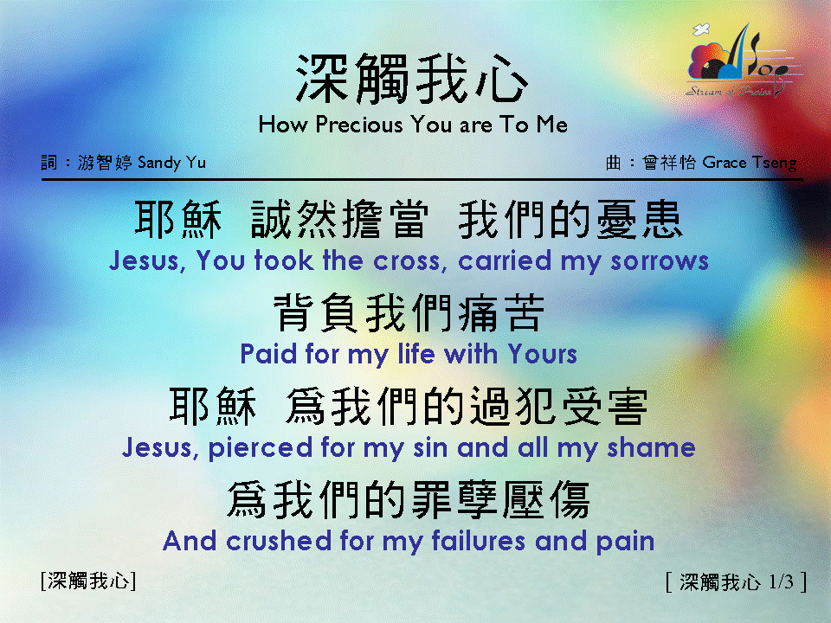
深觸我心 <1/3> How Precious You are To Me

Slide 2
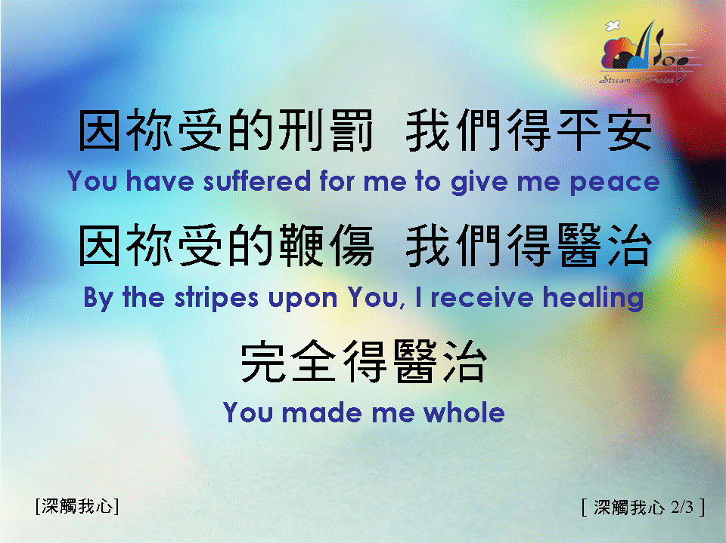
深觸我心 <2/3> How Precious You are To Me

Slide 3
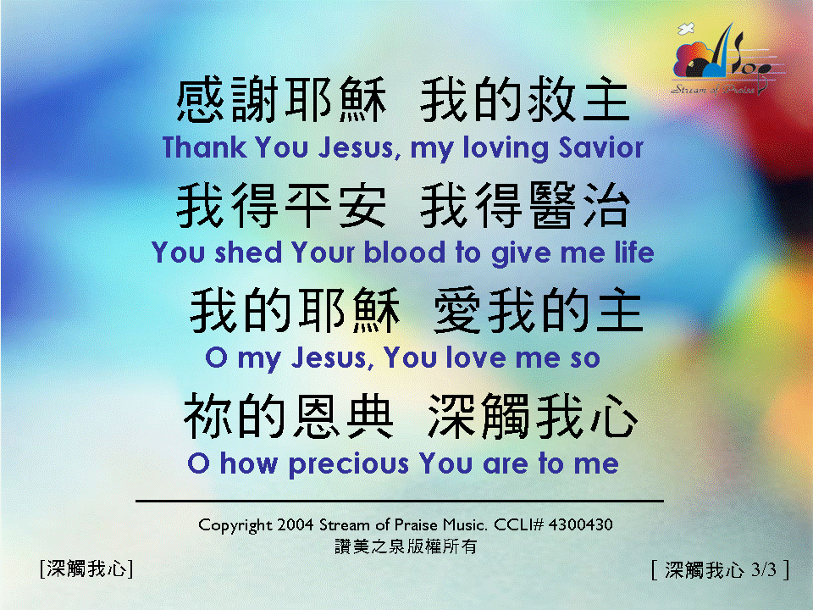

深觸我心 <3/3> How Precious You are To Me

